Slide 1
A/B Testing

Slide 2
A/B Testing
Also known as split testing
refers to a randomized experimentation process wherein two or more versions of a variable (web page, page element, etc.) are shown to different segments of website visitors at the same time to determine which version leaves the maximum impact and drive business metrics.
In marketing world, It is a marketing experiment wherein you split your audience to test a number of variations of a campaign and determine which performs better
Enables data-driven decisions over guesstimate/intuition/assumptions based decisions.
Mostly used in website designing (landing pages/CTA), marketing campaigns (email/flyers) .
Notes:
https://vwo.com/ab-testing/

Slide 3
A/B Testing
Benefits of A/B testing:
Solve visitor pain points
Get better ROI from existing traffic
Reduce bounce rate
Make low-risk modifications
Achieve statistically significant improvements
Redesign website to increase future business gains
Notes:
https://vwo.com/ab-testing/
https://blog.hubspot.com/marketing/how-to-do-a-b-testing

Slide 4
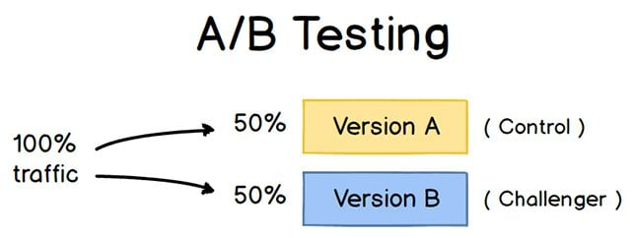
How to do A/B Testing
1. Decide independent variable to test such as color of web-page, size of CTA etc
2. Identify goal or target metric (dependent variable)
3. Create two different versions of one piece of content,
with changes to a single variable
‘A’ refers to ‘control’ or ‘original condition’
‘B’ refers to ‘variation’ or ‘Challenger’ or a new version of
the original testing variable.
4. Split your testing sample into equal and randomly
5. Show two versions to both audiences and analyse which one performed better over a specific period of time (long enough to make accurate conclusions about your results).
Notes:
https://blog.hubspot.com/marketing/how-to-do-a-b-testing

Slide 5
A/B Testing
Multivariate testing
Experimentation method wherein variations of multiple page variables are simultaneously tested to analyze which combination of variables perform the best out of all the possible permutations
total number of versions in a multivariate test:
[No. of variations of element A] x [No. of variations of element B] x [No. of variations of element C]… = [Total No. of variations]
Multivariate testing can help eliminate the need to run multiple and sequential A/B tests on a web page with similar goals
Notes:
https://vwo.com/ab-testing/

Slide 6
H2O

Slide 7
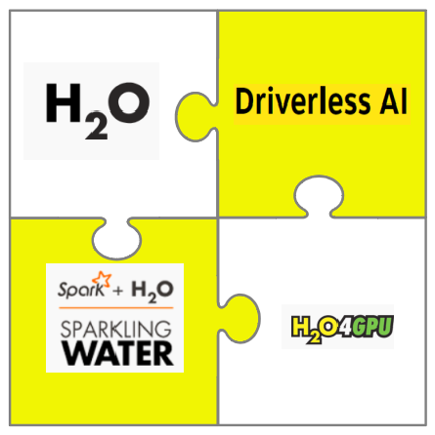
H2O.ai
http://www.h2o.ai
H2O.ai offers a suite of Machine Learning platforms.
H2O’s core strength is its high-performing ML components,
which are tightly integrated.
Follow are some of the key major products offered:
H2O platform
Integrations for Apache Spark with Sparkling water
Automatic machine learning platform
H2O Driverless AI platform
H2O Wave

Slide 8
H2O Platform
H2O is an open-source, distributed in-memory machine learning platform
H2O’s core code is written in Java and JVMs are required to run H2O.
The platform includes interfaces for R, Python, Scala, Java, JSON and CoffeeScript/JavaScript
It supports :
Data science project development capabilities
Built-in Web interface “Flow”
Auto-ML
Sparkling Water (Spark is required if you want to run Sparkling Water.)
H2O is designed to run in standalone mode, on Hadoop, or within a Spark Cluster

Slide 9
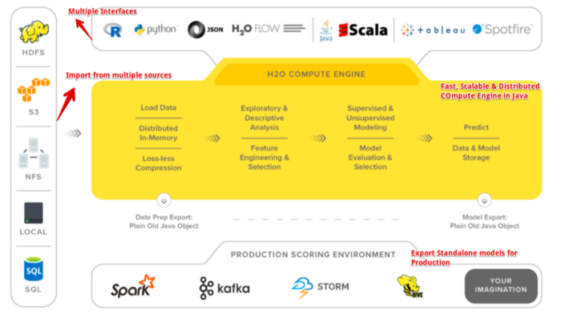
H2O Architecture
H2O makes it possible to import data from
multiple sources and has a fast, Scalable &
Distributed Compute Engine Written in Java

Slide 10
Machine Learning Algorithms on H2O
H2O includes many common machine learning algorithms, such as generalized linear modeling (linear regression, logistic regression, etc.), Naive Bayes, principal components analysis, k-means clustering, and others.
H2O also implements best-in-class algorithms at scale, such as distributed random forest, gradient boosting, and deep learning.

